Slide 1



Innovative Sustainability Code
Earth And US
Live Smart
Represented By:
Rana El-Kady
Nehal Mahfouz
Team members:
Rana El-Kady Nehal Mahfouz
Ahmed Youssry Amr Ahmed

Slide 2
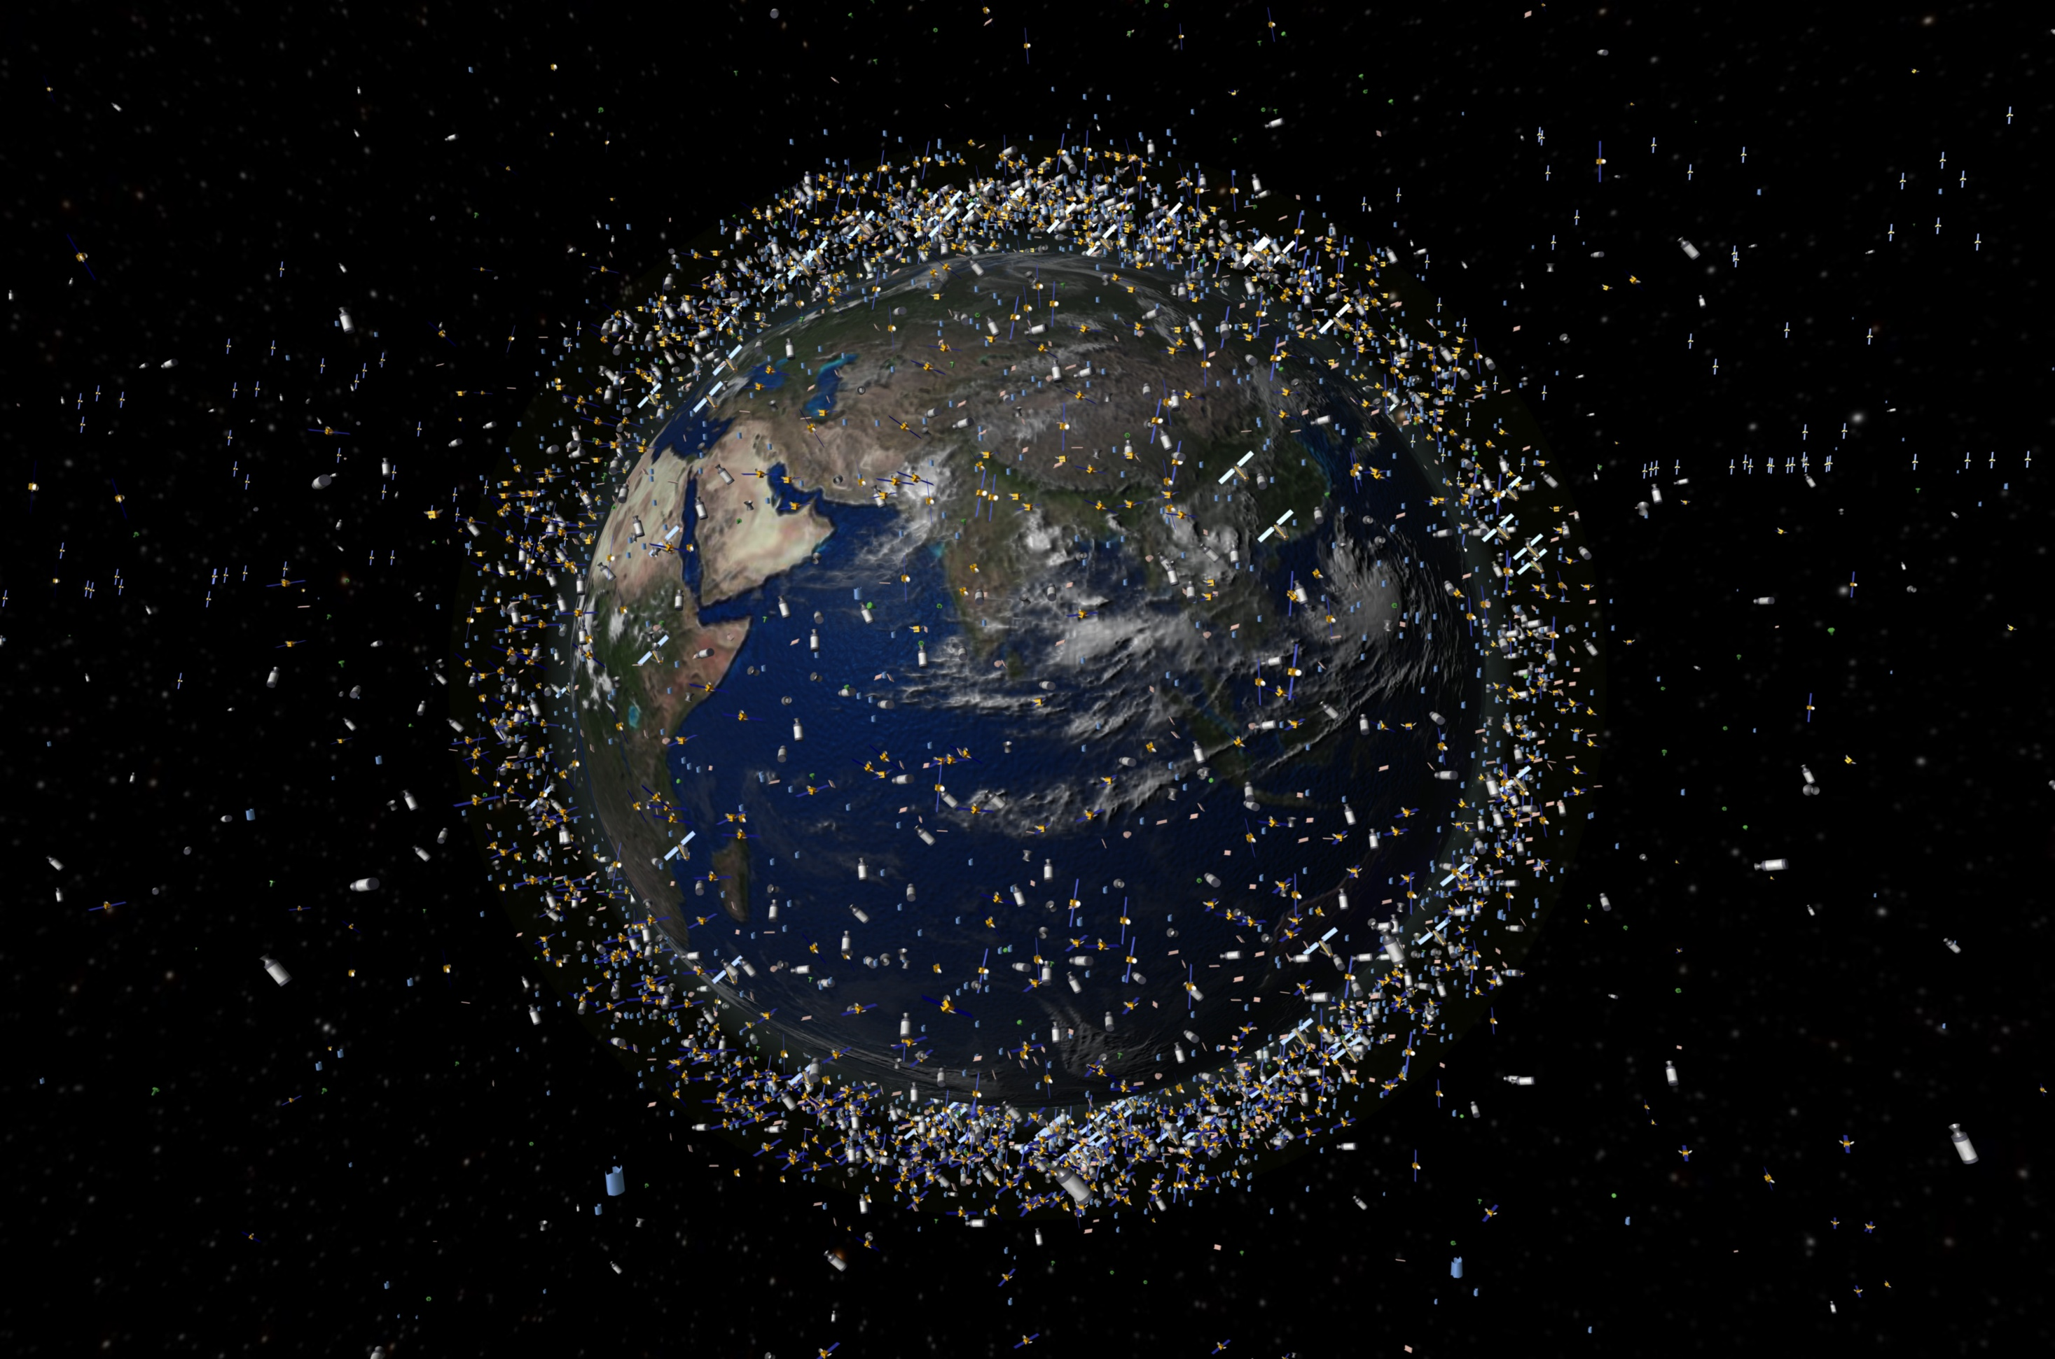
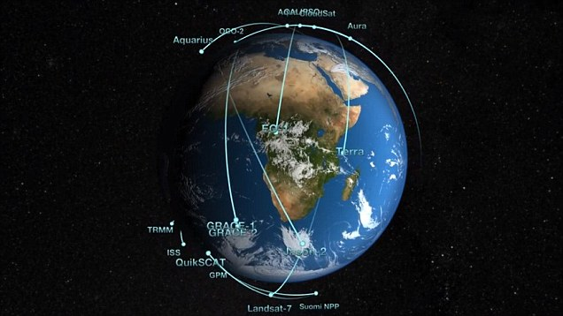

Slide 3
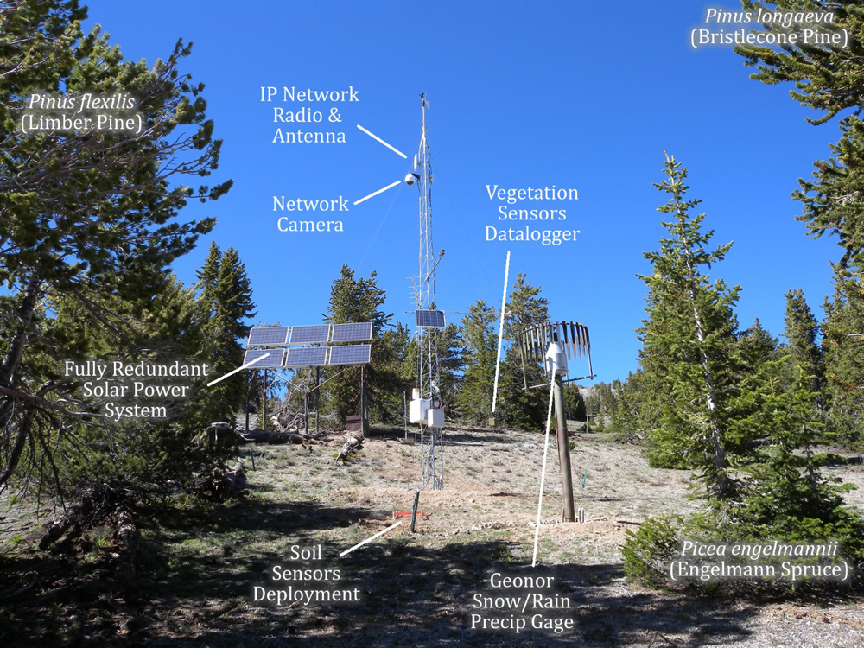
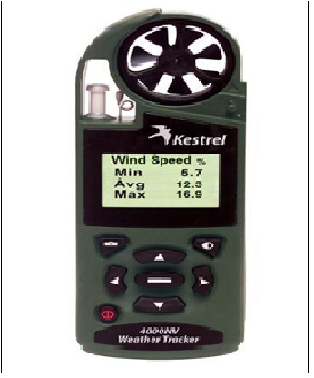

Slide 4
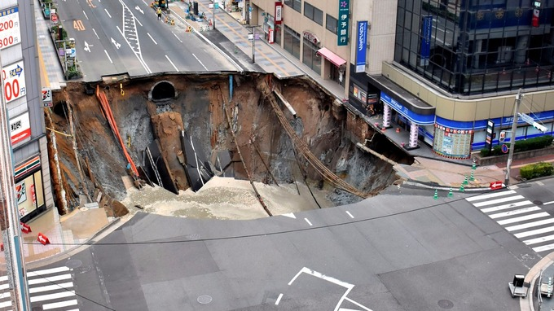
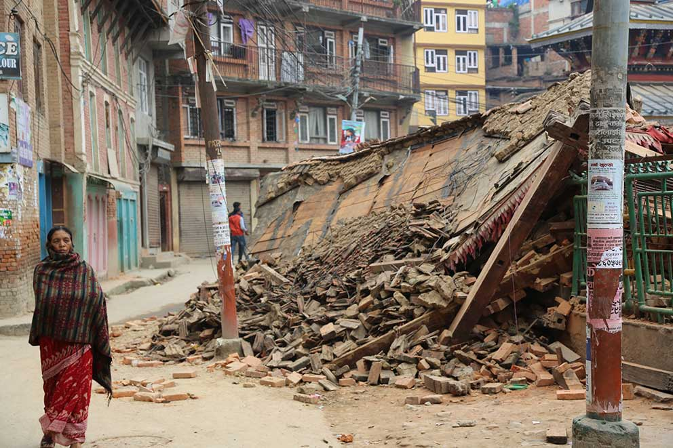
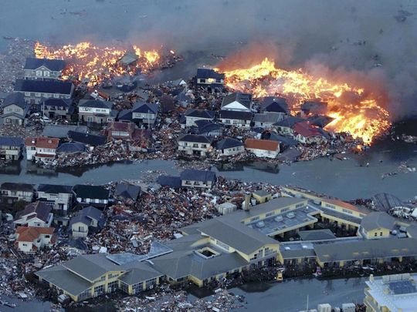
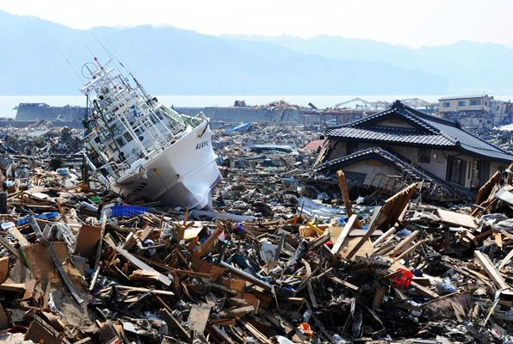
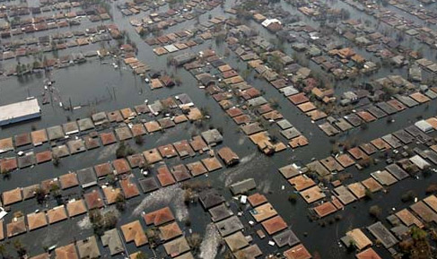

Slide 5
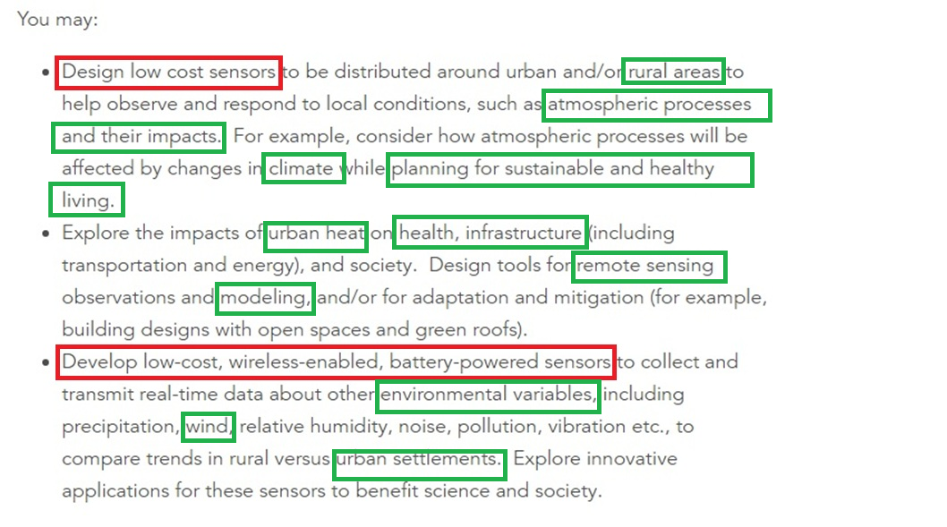
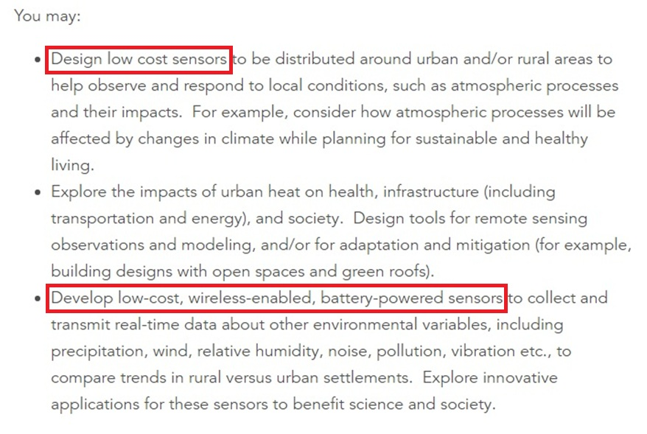
Challenge Purposes and Achievements
There are a large set of variable sensors which provide giant data categories ; so we decided that sensors are not the issue itself , it is better to focus on about how to use the acquired data and to integrate them.

Slide 6
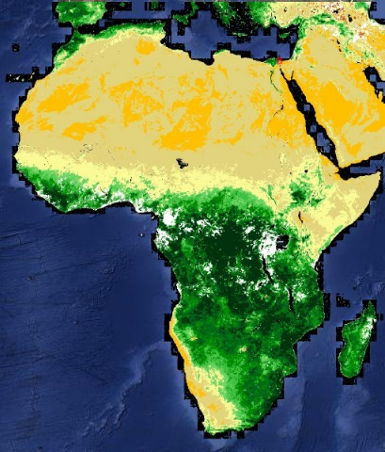
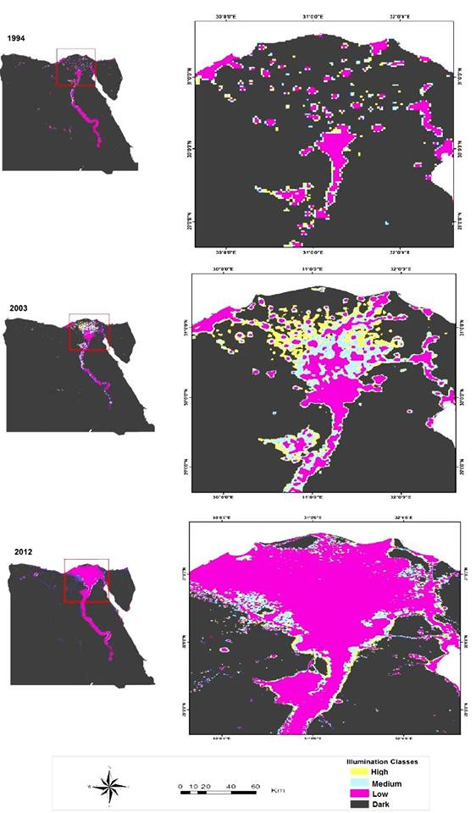
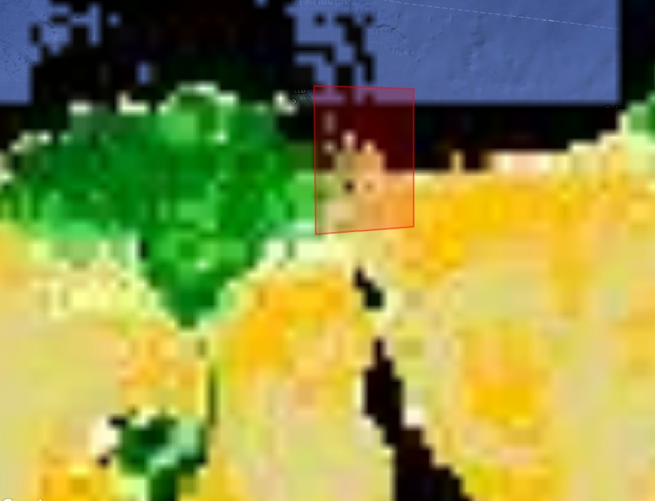
The Problem due to
The Low Resolution of some Satellite Images used Such as VIIRS and eMODIS NDVI

Slide 7

The Problem due to
No connection between different types of Data

Slide 8
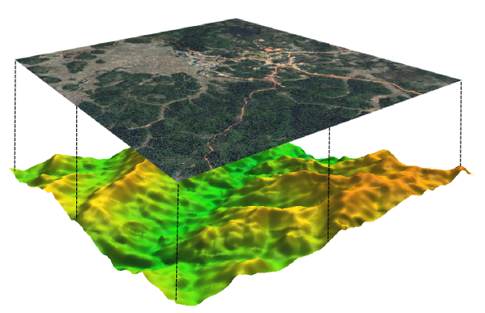
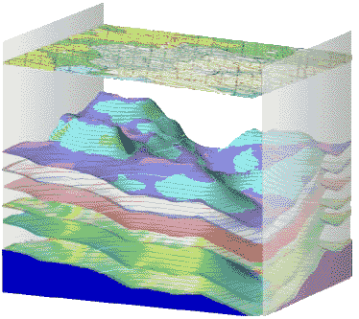
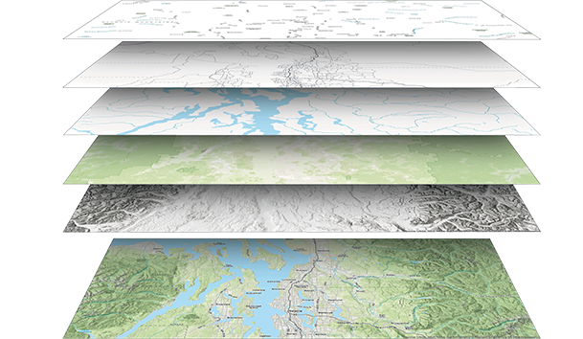
Materials and Methods (Modeling Code)
Satellite Imagery
Field &Lab Data
Sub Surface Data
Field & Lab Data Used :
Climatic Data
Elevation Data
Hydrogeology
Hydro-geochemistry
Data: Created:
Interpolated Wind potential mapping
Rain intensity map
DEM
Groundwater chemistry & resource maps
Satellite Data Used :
Land Sat MSS - Land Sat 4 , 5
Land Sat 7 - Land Sat 8
Data: Created:
NDVI
Thermal Map
Coastline Change detection
Urban and Roads
Sub Surface Data Used :
Gravity and Magnetic Survey Data
Borehole Data
Data: Created:
Deeper Tectonic Framework (Faults) Map
Subsurface Geologic layers maps

Slide 9

Materials and Methods
Satellite Imagery
Field Data
Sub Surface Data
Code

Slide 10
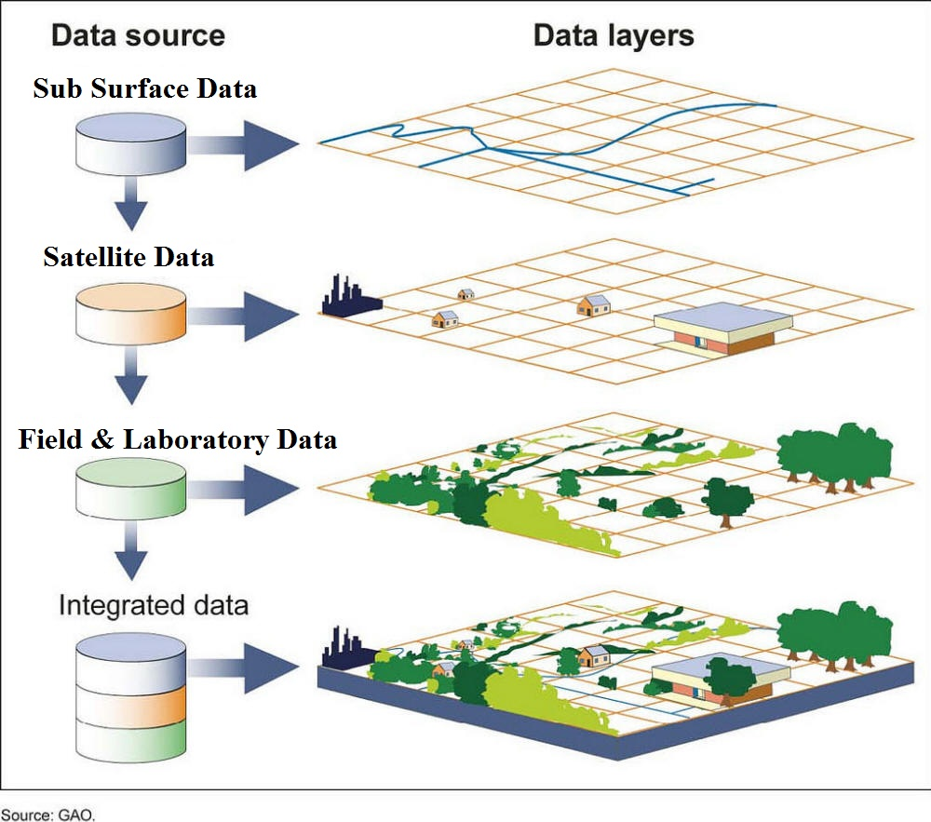
Materials and Methods
Urban Code (Strategic Plan)
Advantage of the
Modelling Solution
1- Applicable on large packages of Data varieties.
2- Codes could be easily edited or changed.
3- integrated easily on Mobile App or website to be used all over the world.
4- Used not only for urban planning but also in site selection.
5- suitability index of the project could be used to decide optimum wind farm sites.

Slide 11
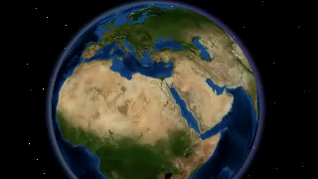
Study Area: Port Said
NE Nile Delta. In Front of Mediterranean Sea

Slide 12
Plan of Work
Soil properties
Collecting data from field observations and Satellite Image
Lithology properties
Geo-Environmental Code for urban planning of Port Said Governorate
(Master Strategic Plan)
Groundwater
Urban and Roads
laboratory analysis
Subsurface geologic structures
Climatic Data
DEM & Sea – level rise
Applying the GIS & RS techniques
Coastal erosion

Slide 13
Satellite Imagery
Satellite Image Processing

Slide 14
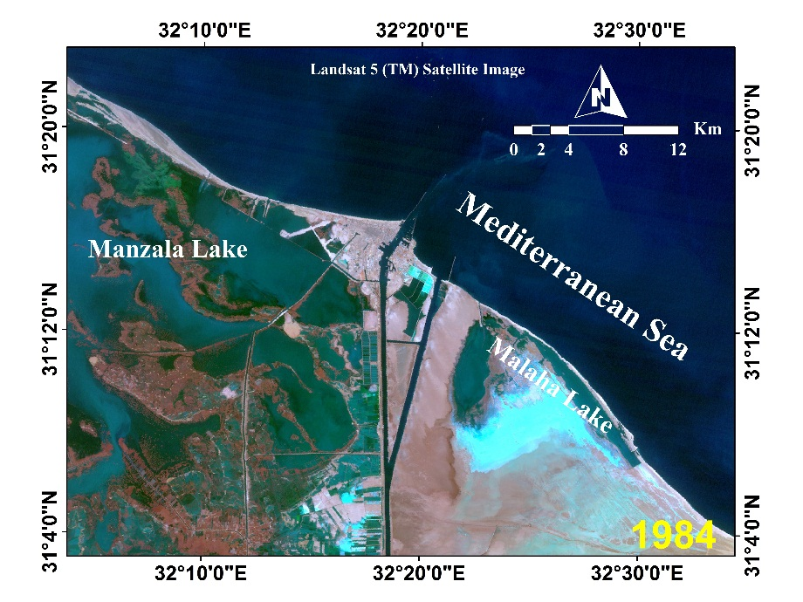
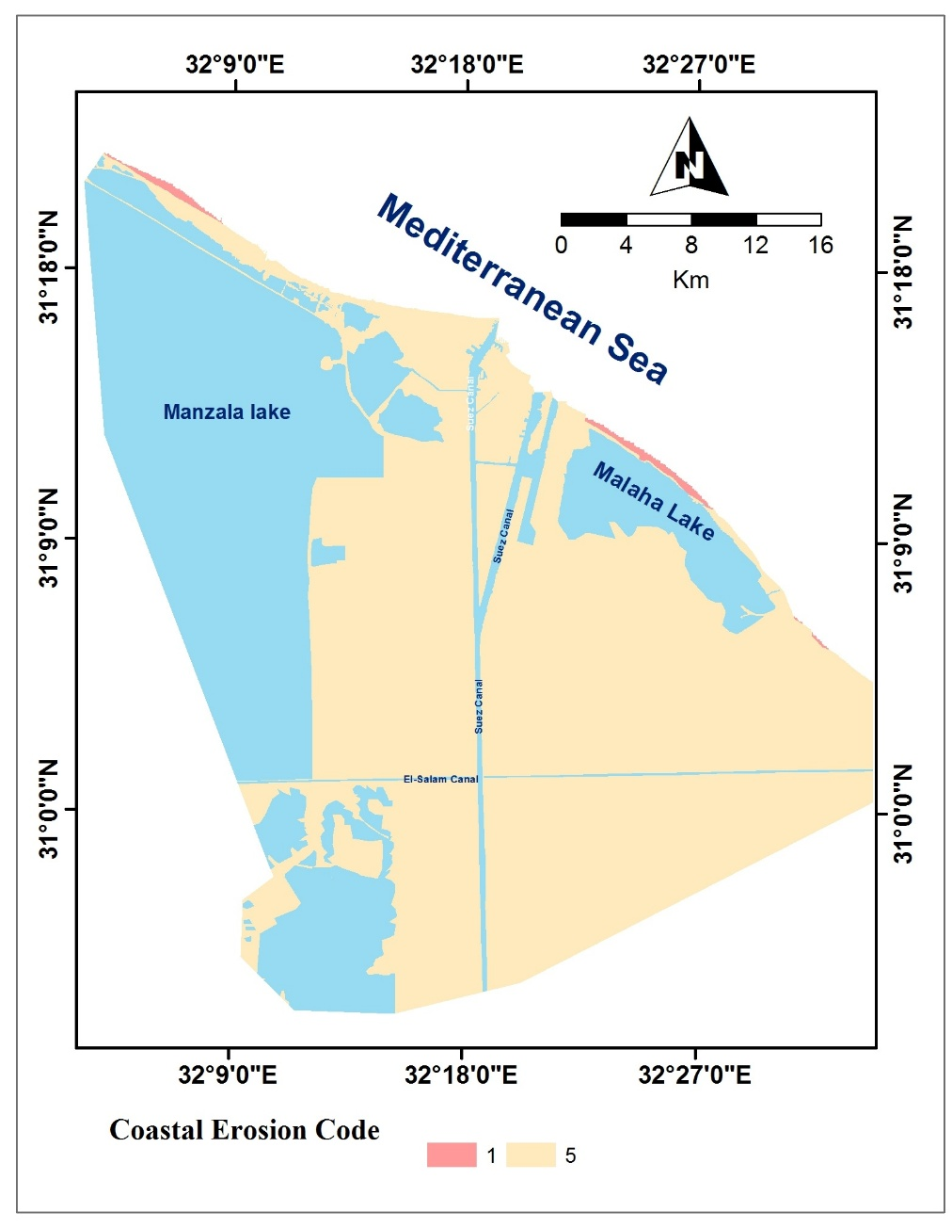
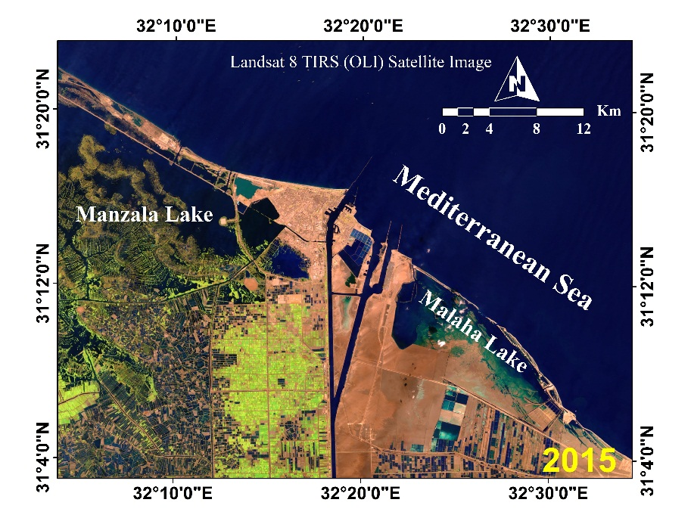
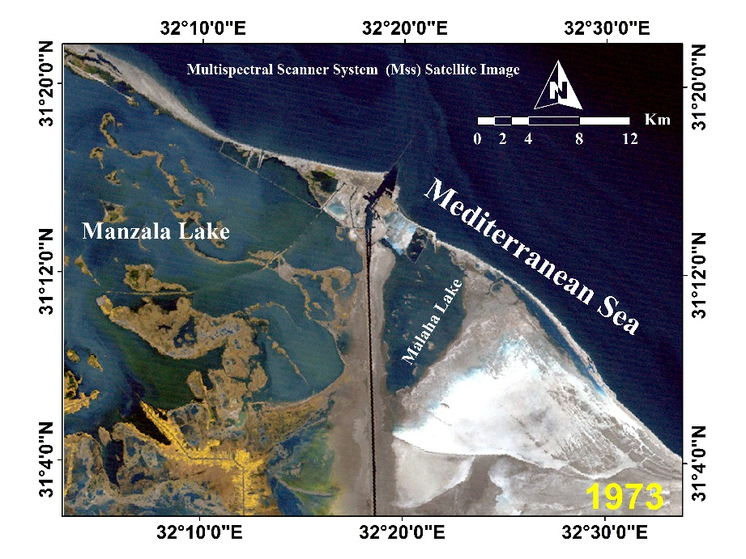
Satellite Imagery
Coastal Erosion Processing
Multispectral Scanner System (Mss)
Bands 4,3,2
Landsat 5 (TM)
Bands 3,4,2
Landsat 7 (ETM)
Band 7,4,2
Landsat 8 TIRS
Band 7,5,3

Slide 15
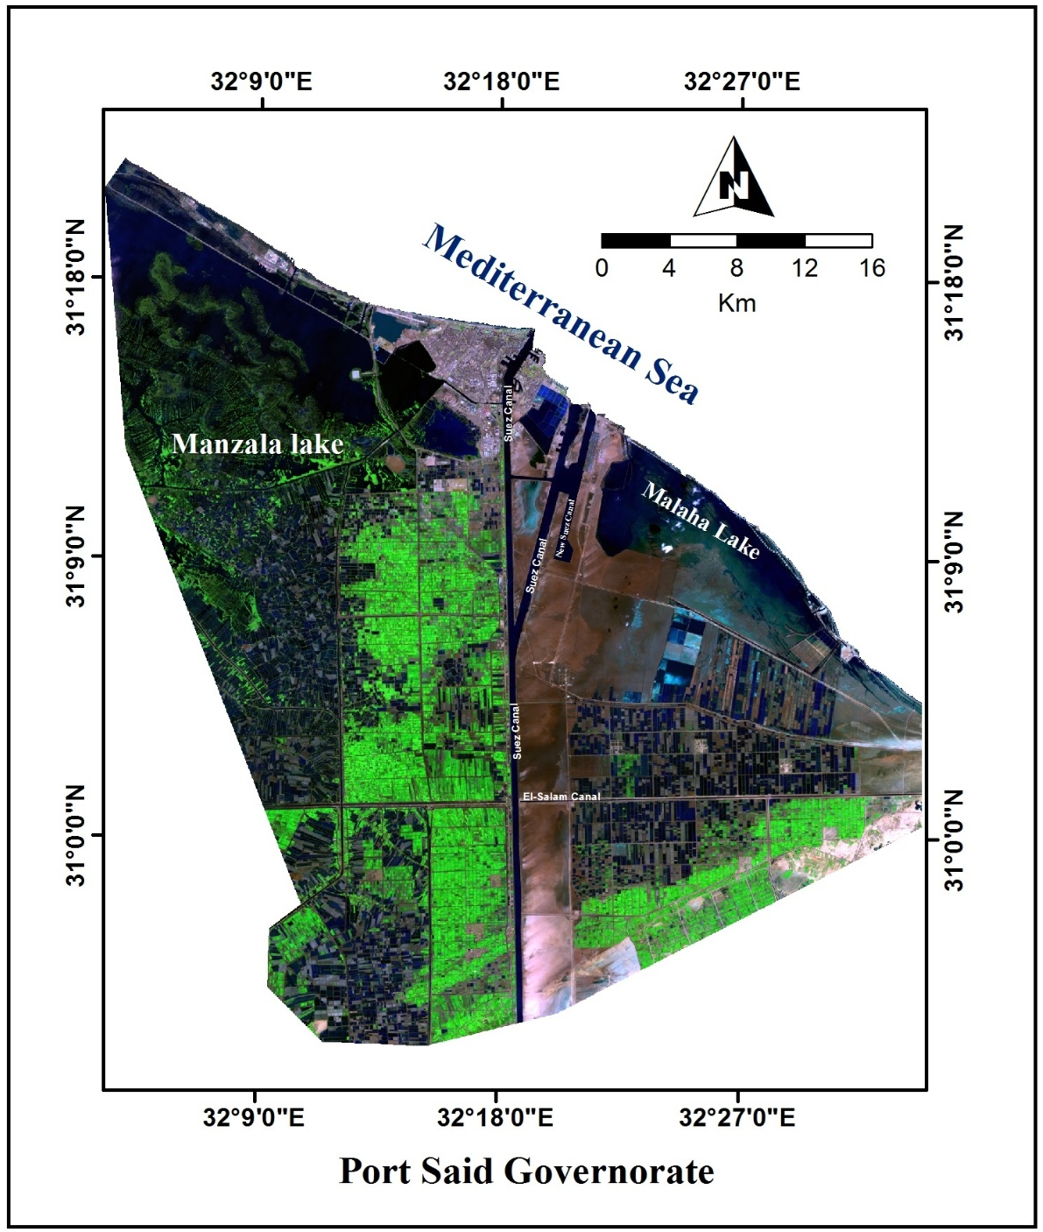
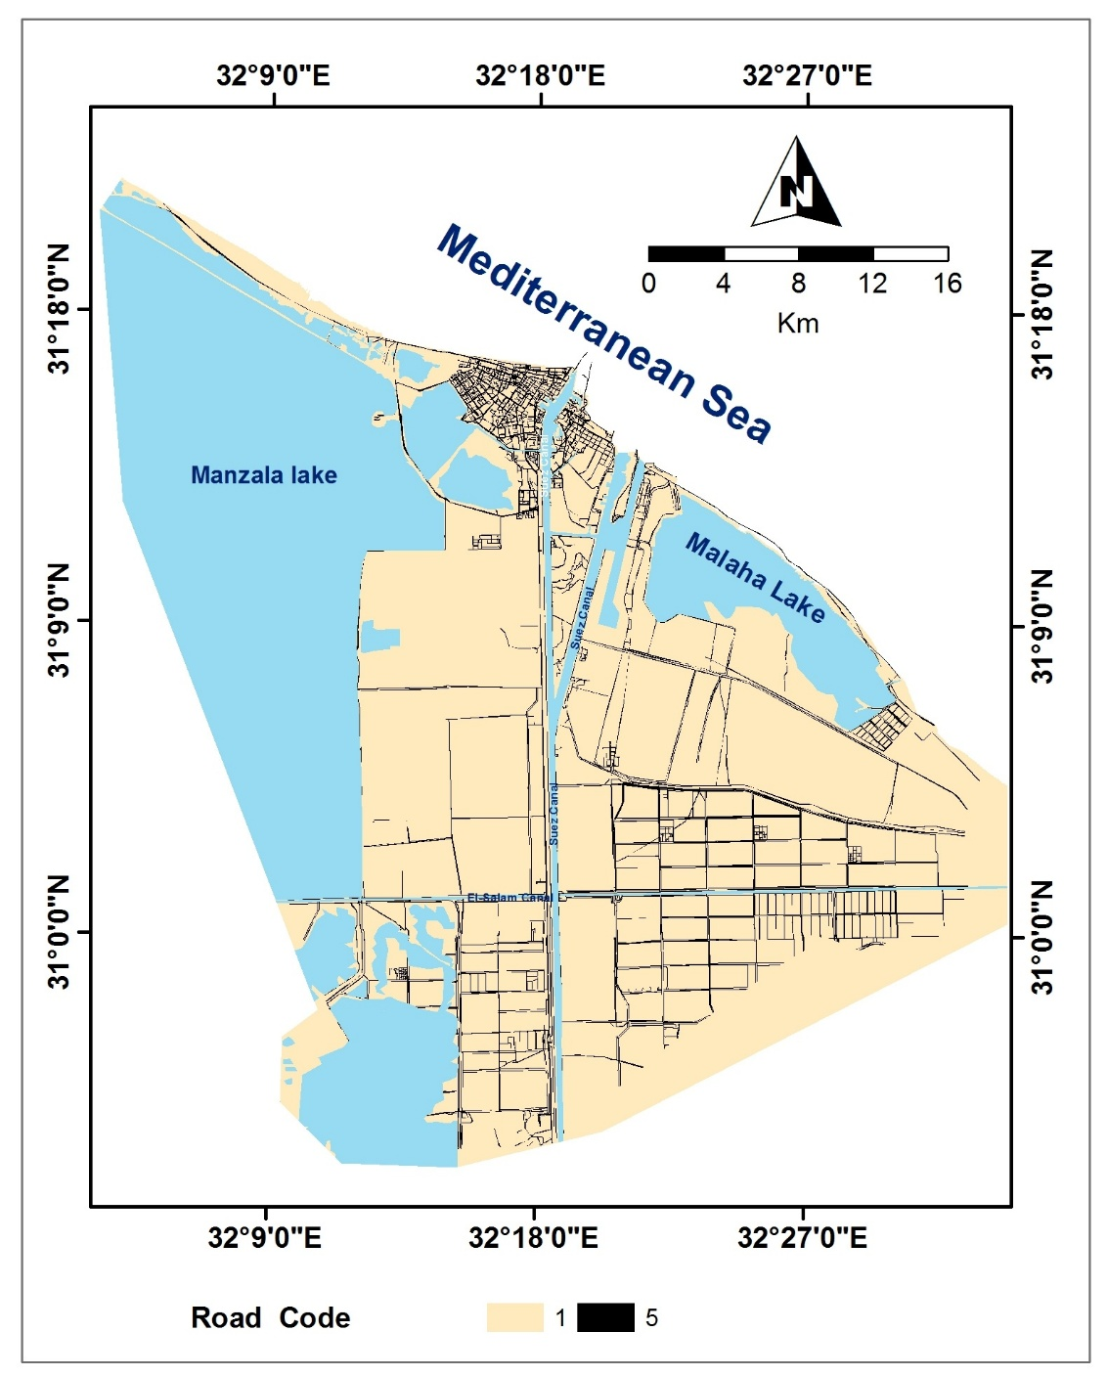
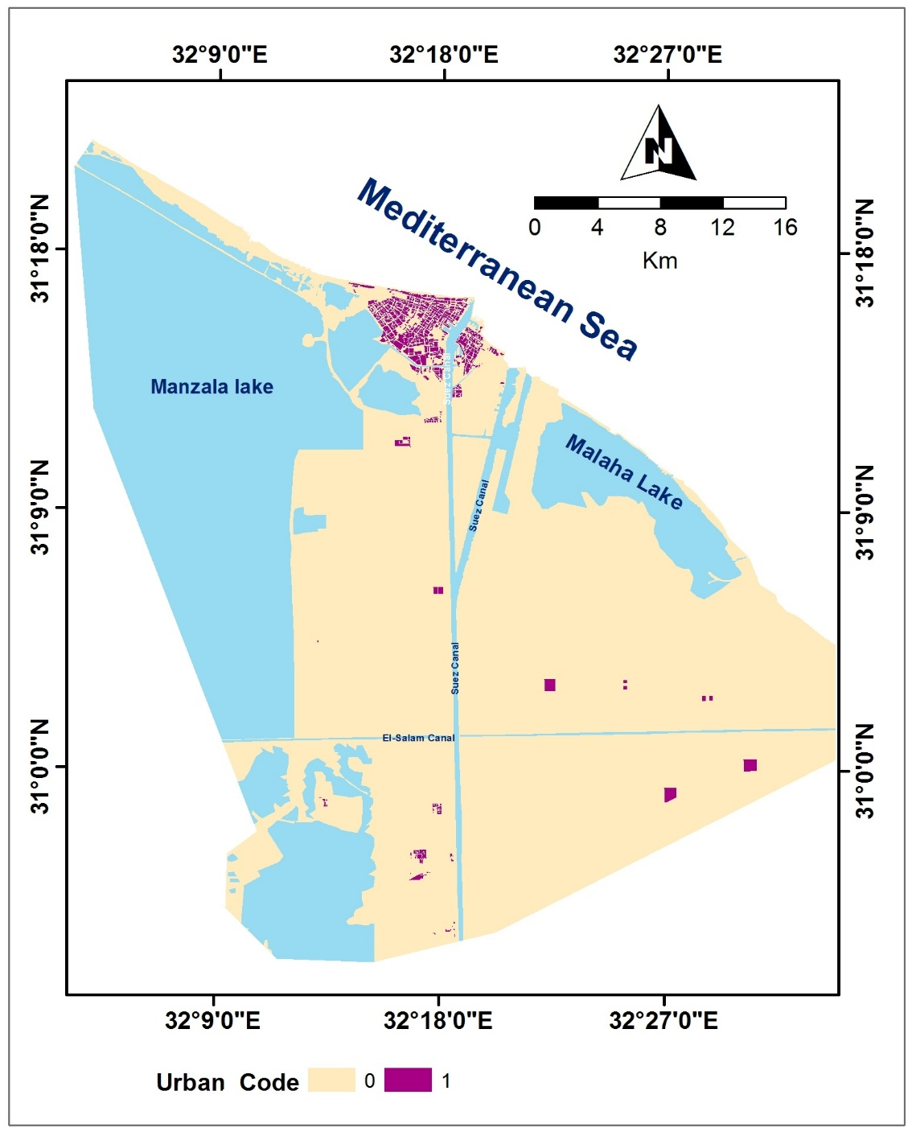
Satellite Imagery

Slide 16
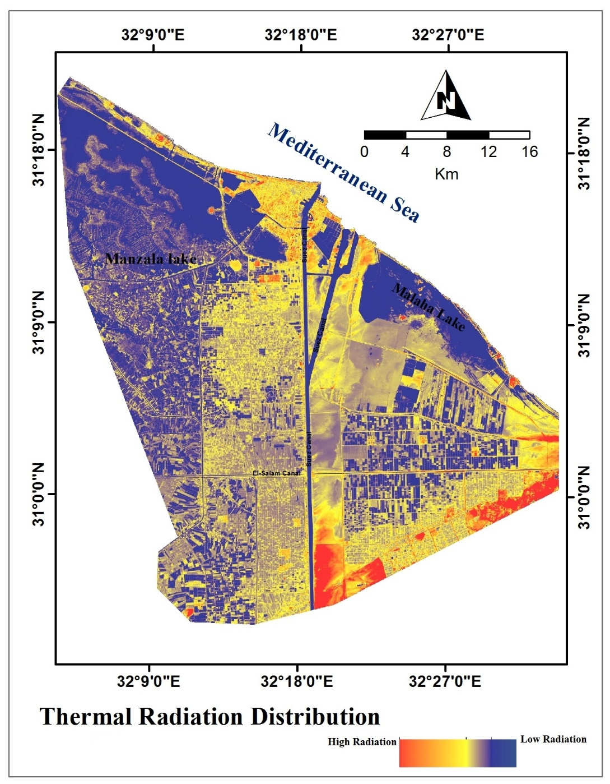
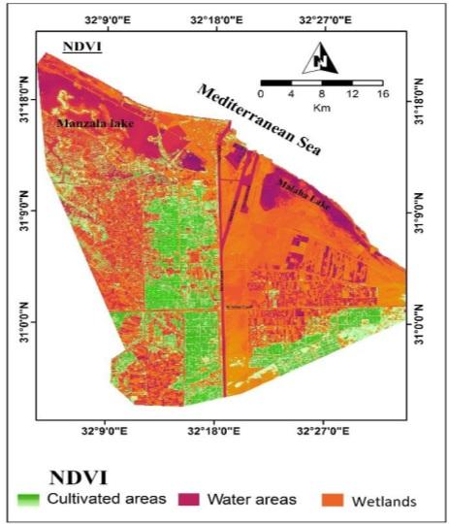
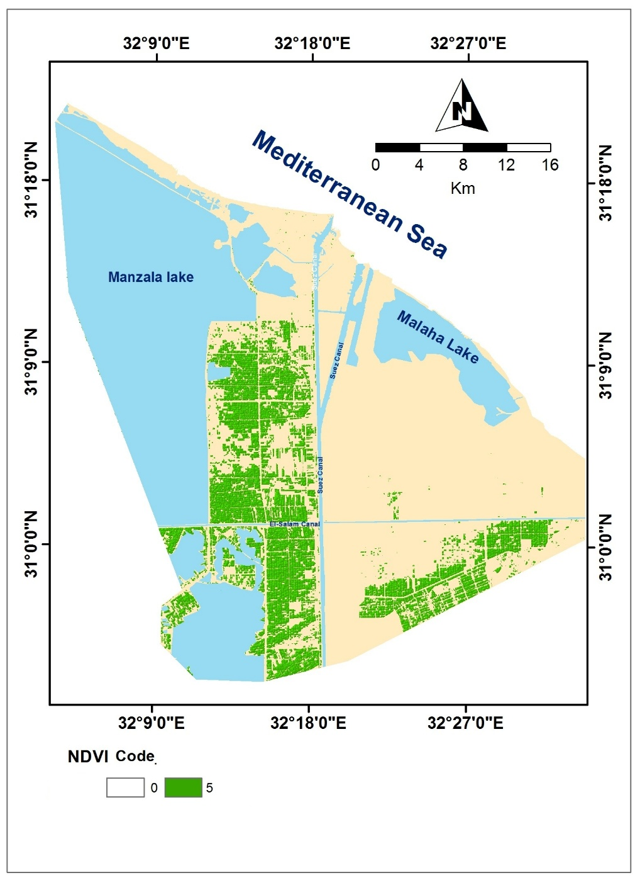
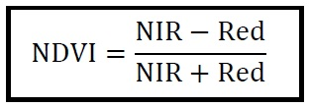
Satellite Imagery
Thermal Radiation
Normalized Difference Vegetation Index (NDVI)

Slide 17
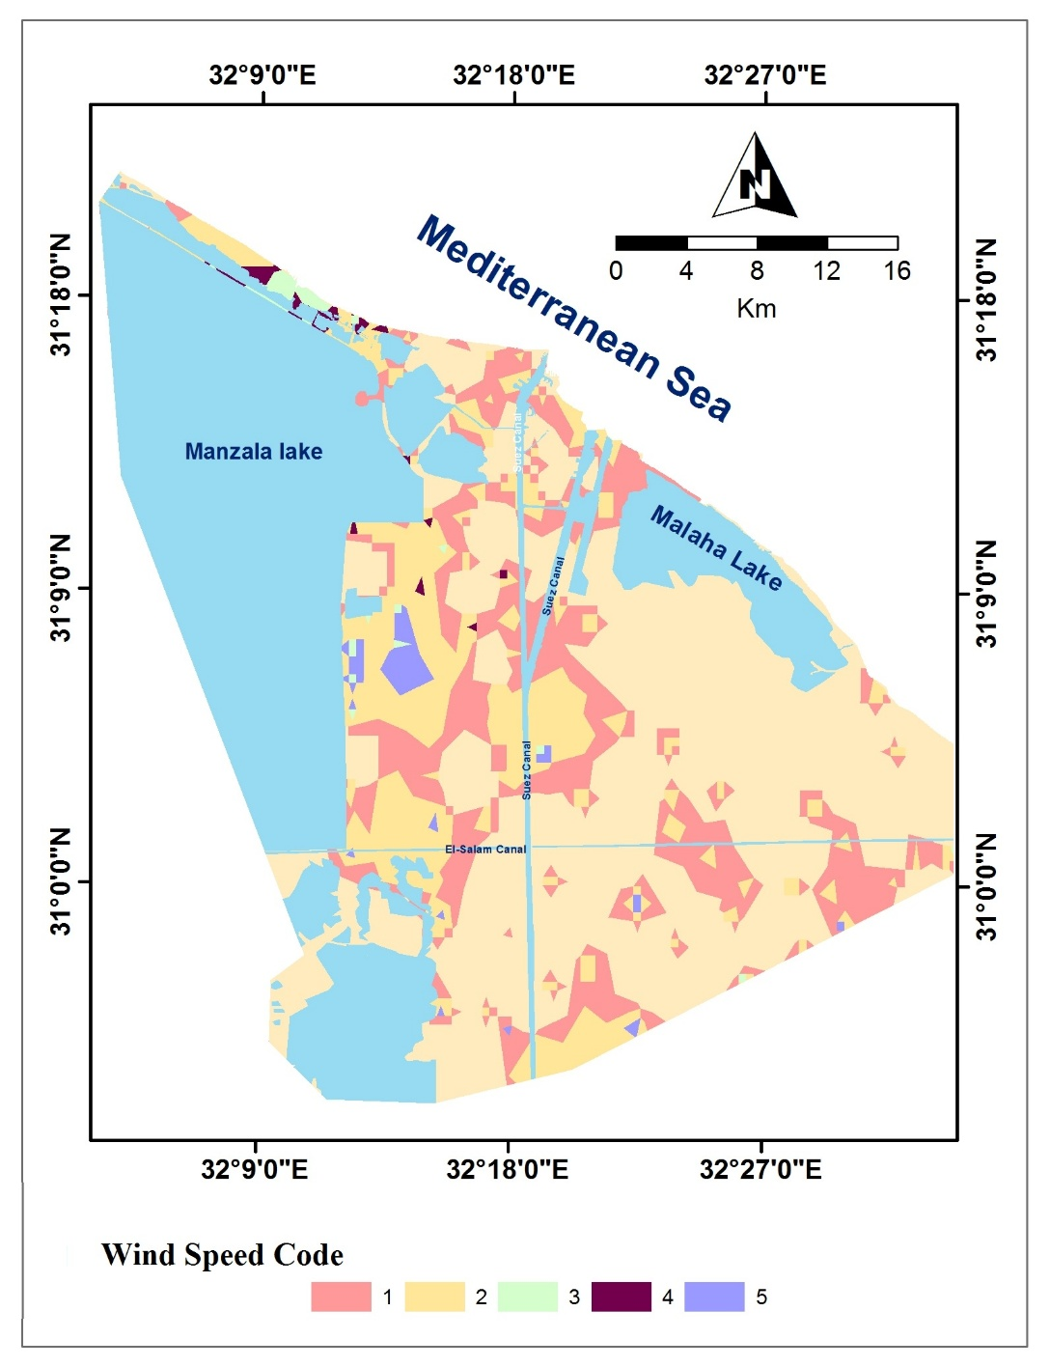
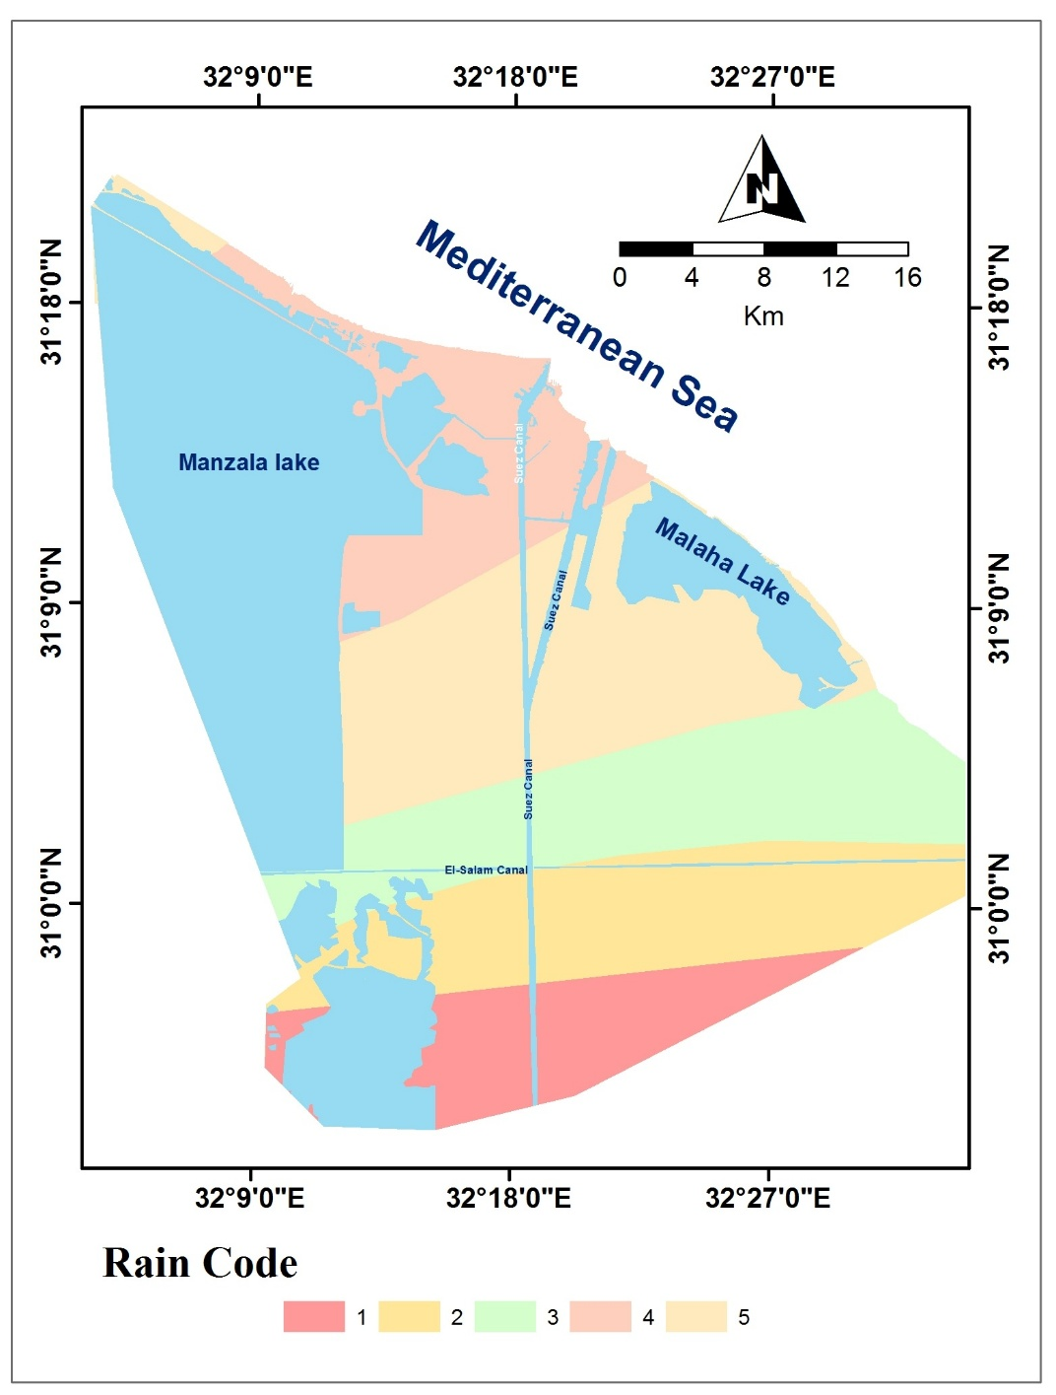
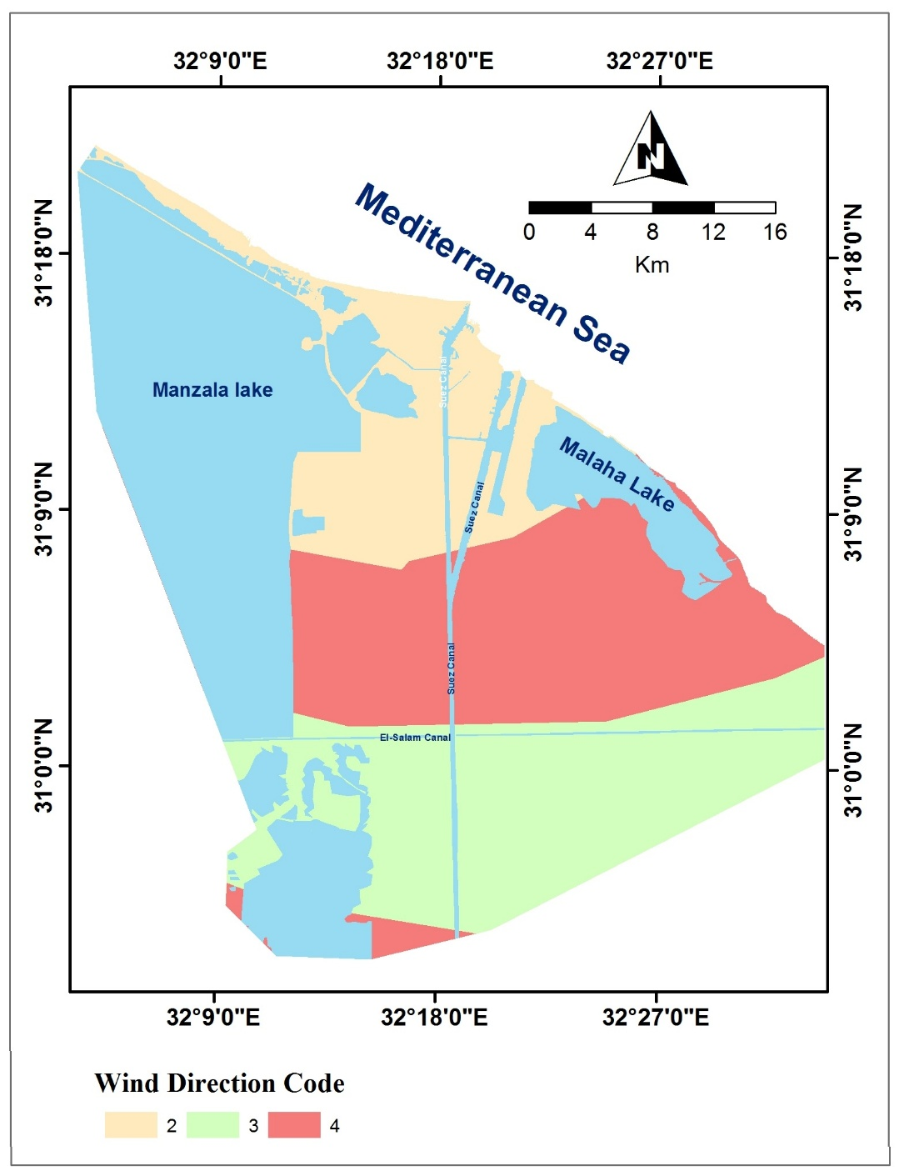
Climatic Data
Interpolated Wind potential mapping Rain intensity
Field &Lab Data

Slide 18
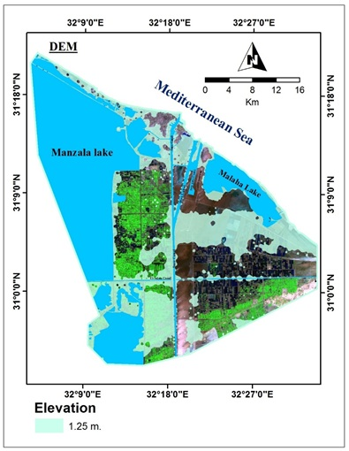
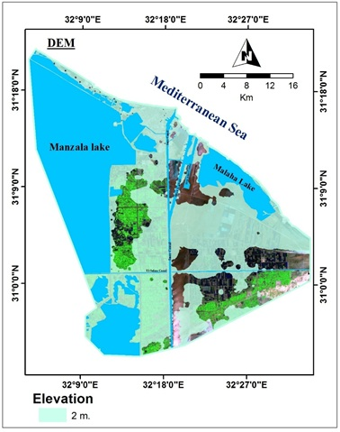
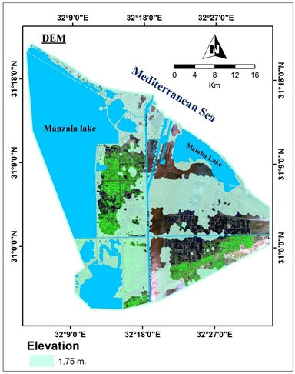
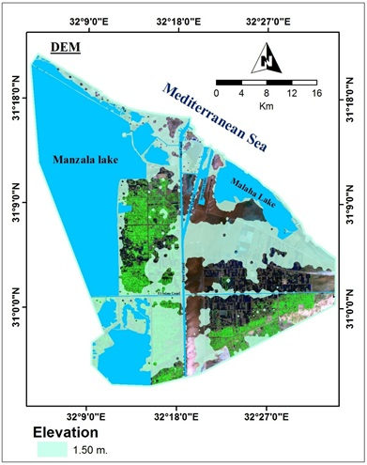
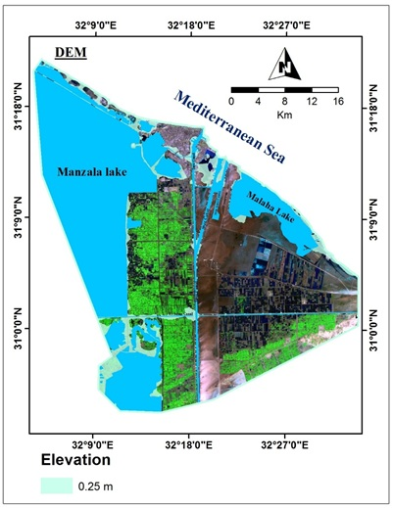
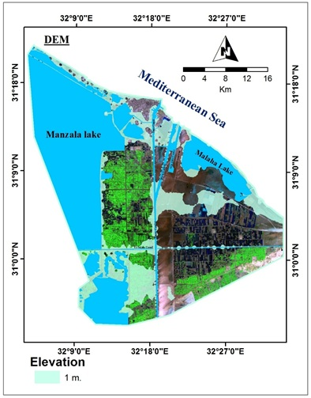
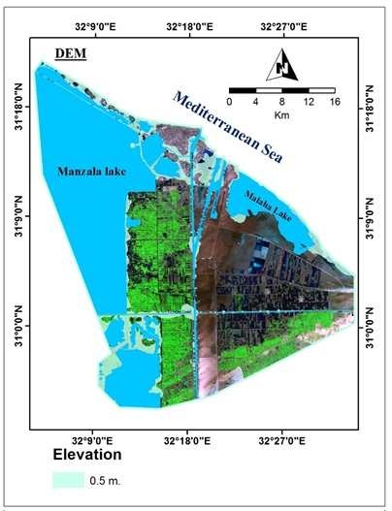

Elevation
Field &Lab Data
DEM Code

Slide 19
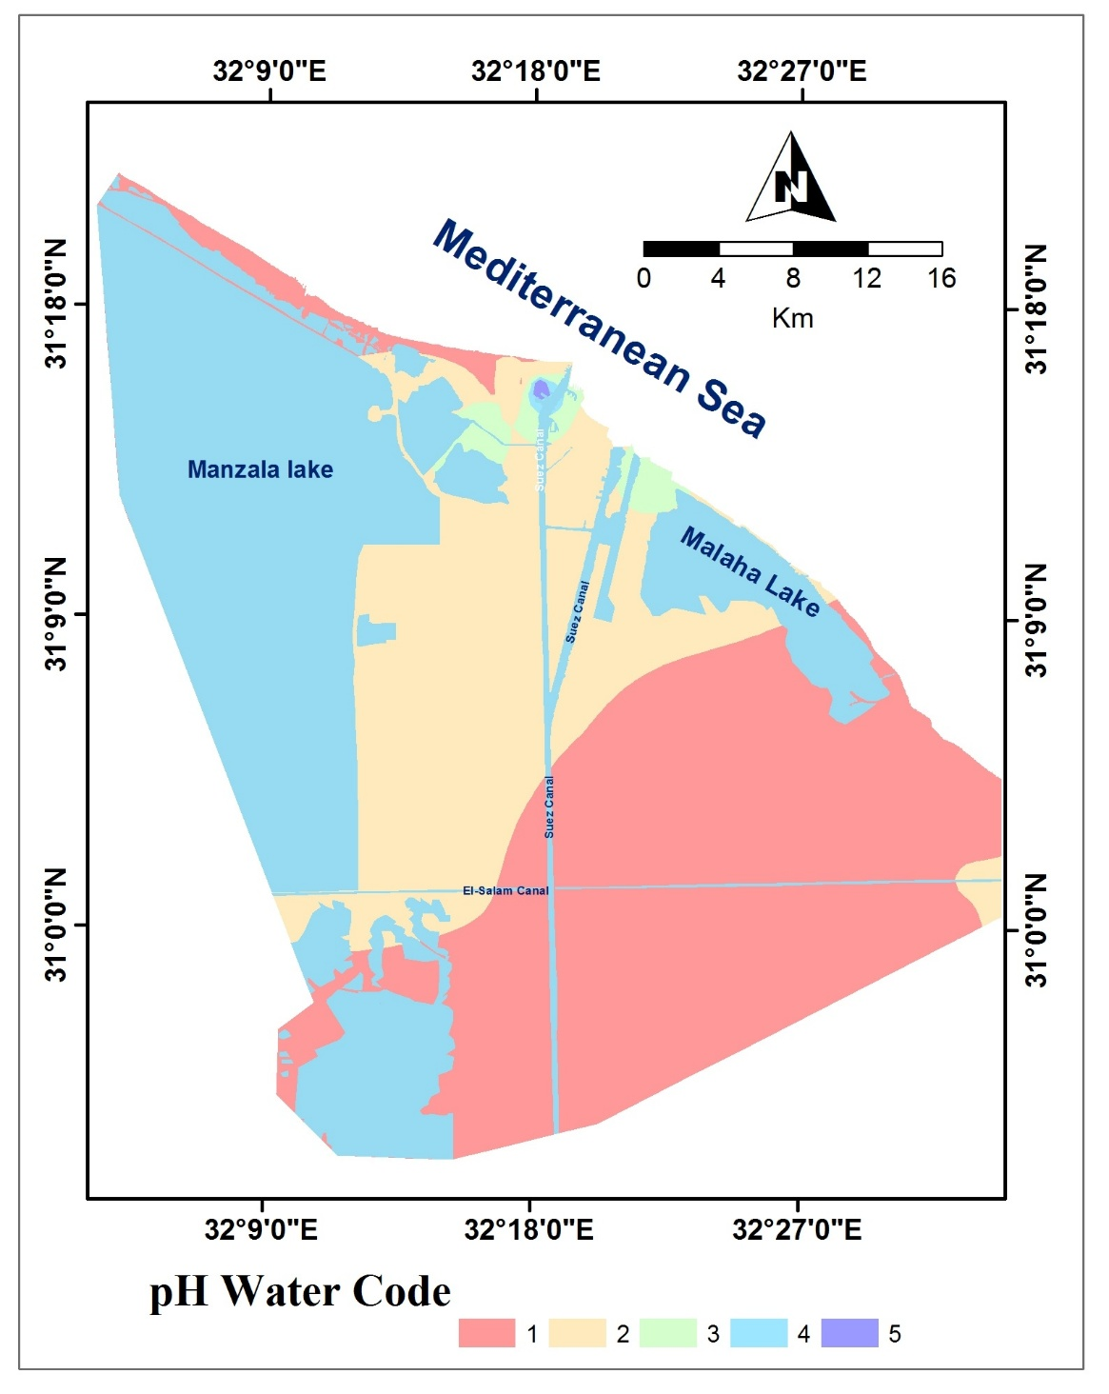
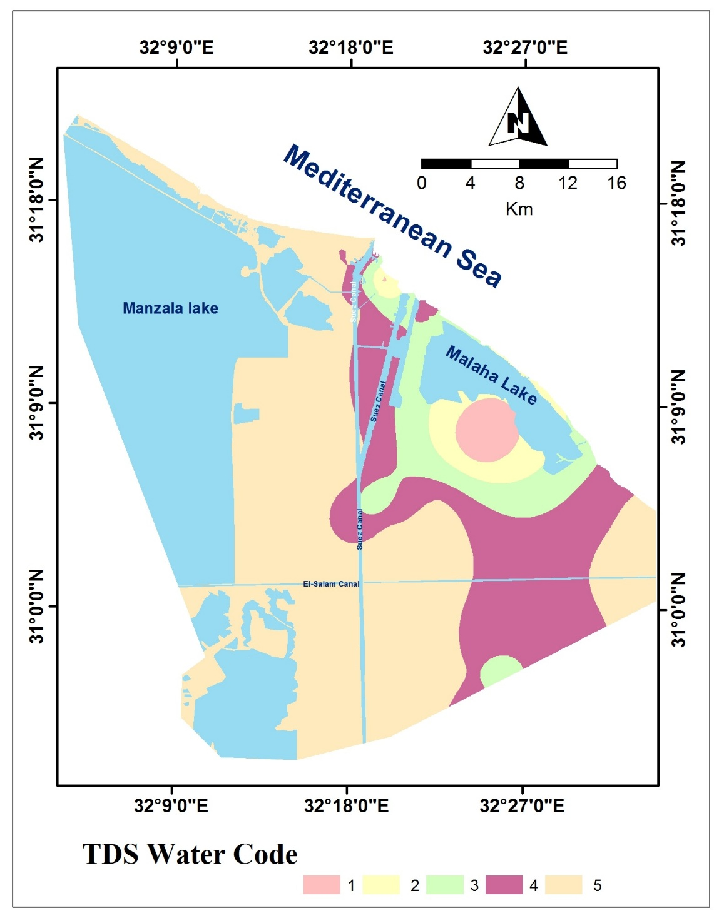
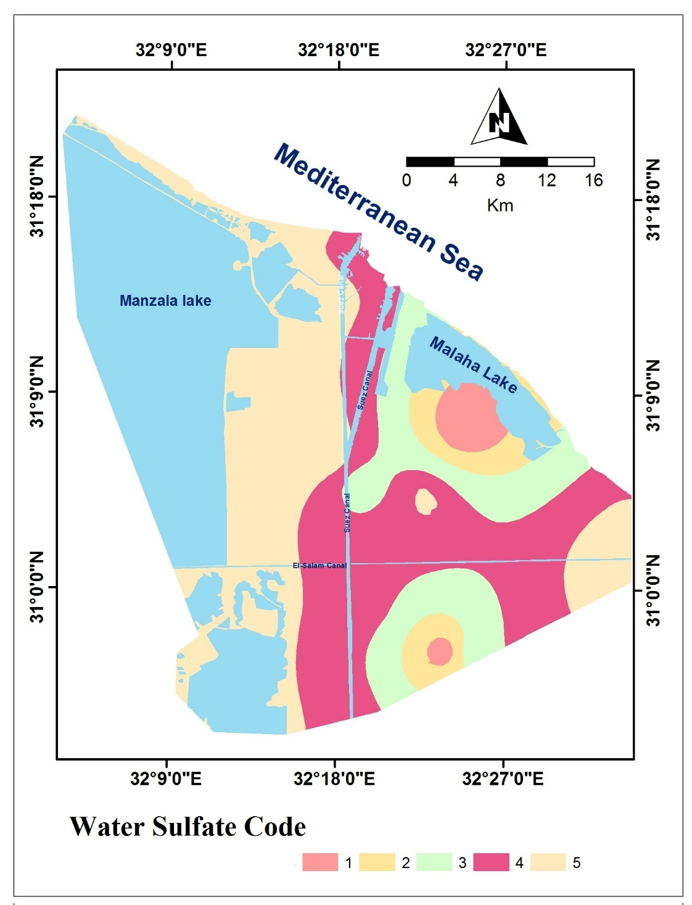
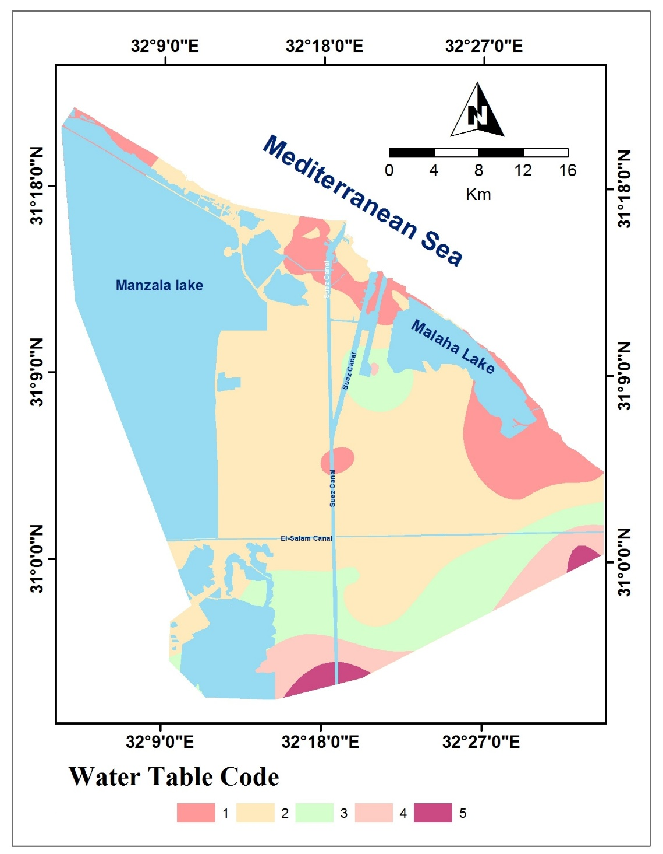
Field &Lab Data
Hydrogeology: Groundwater chemistry & resource maps

Slide 20
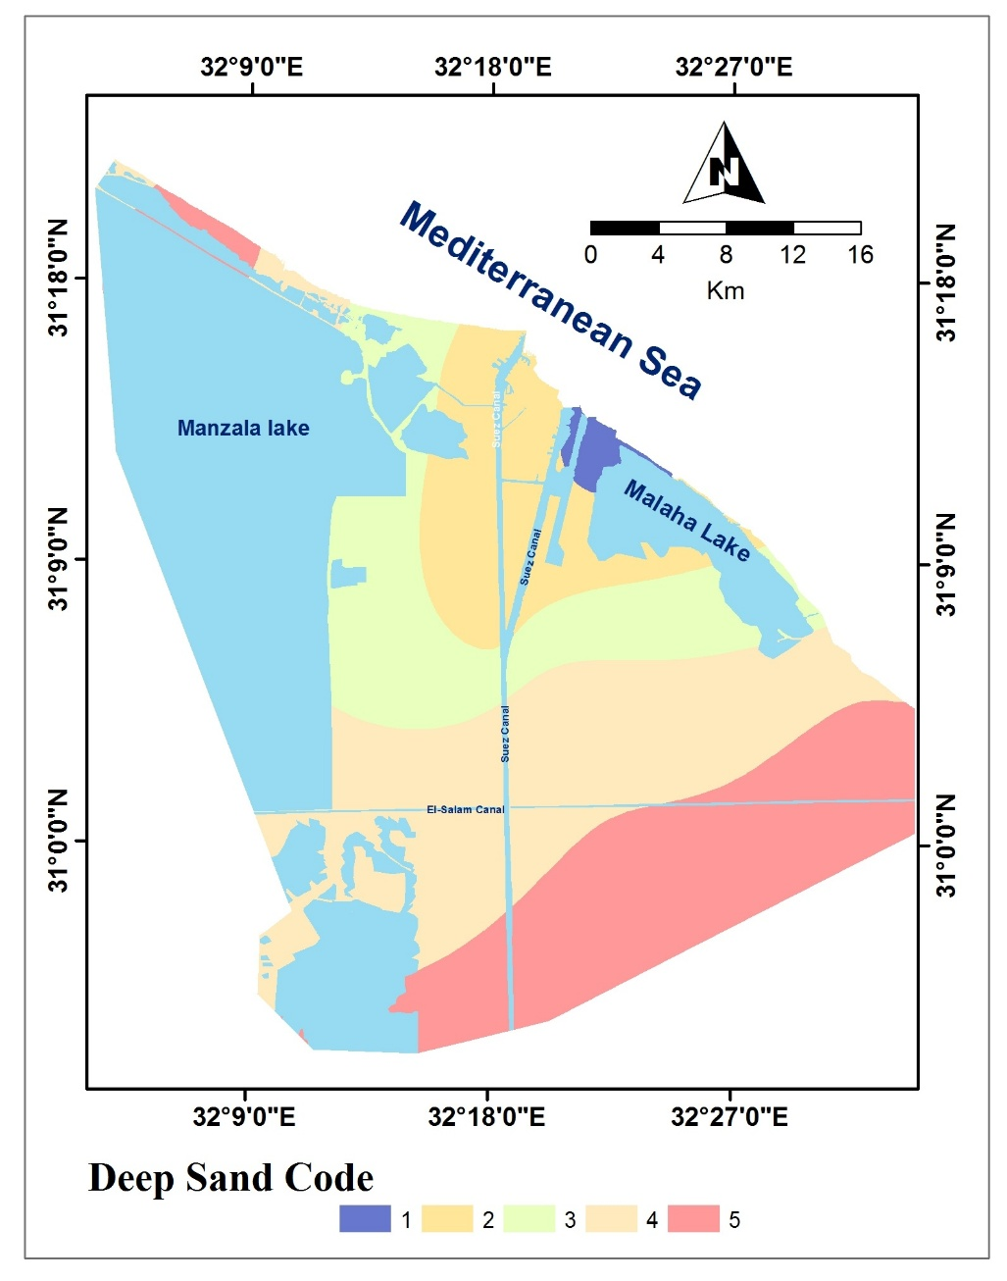
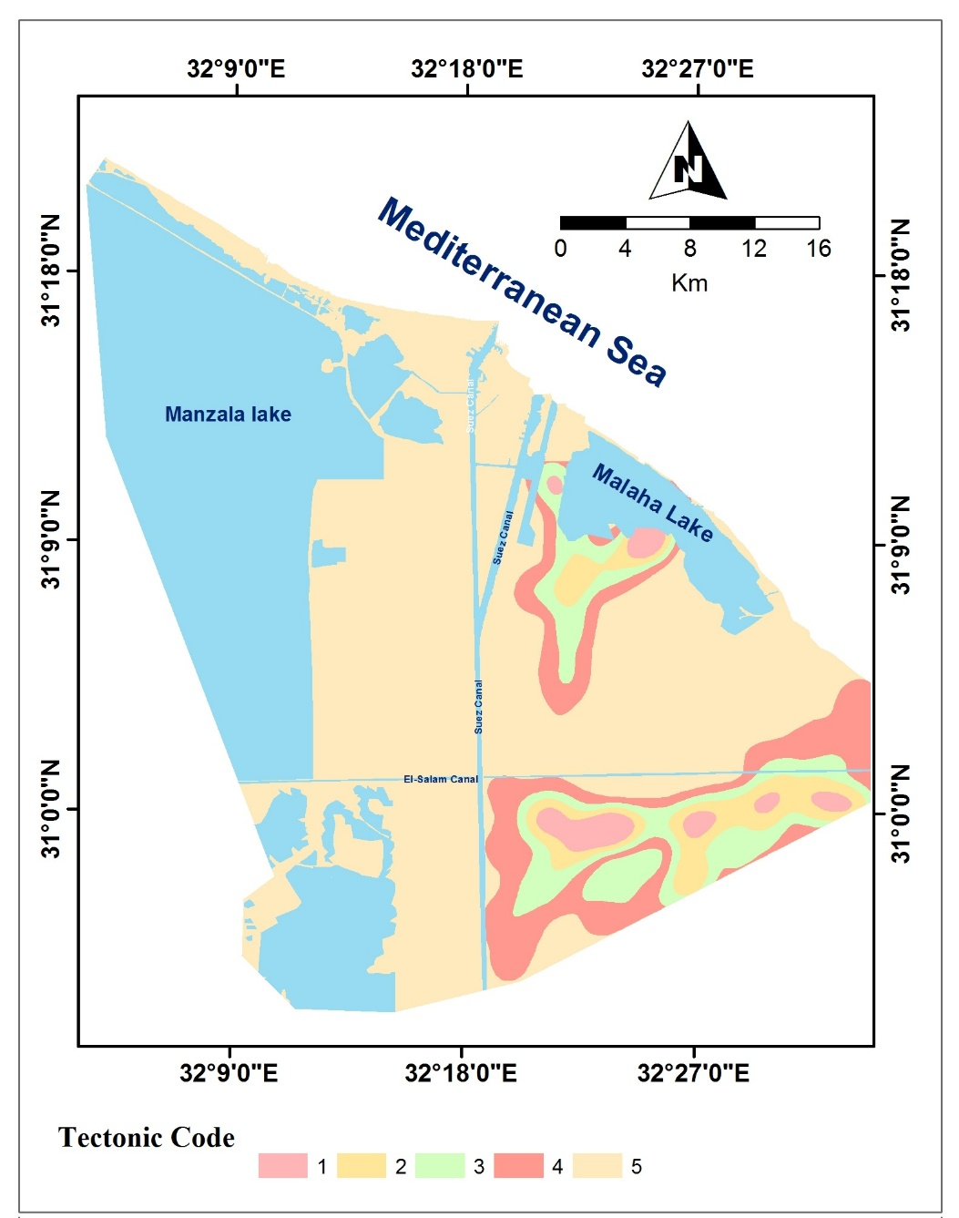
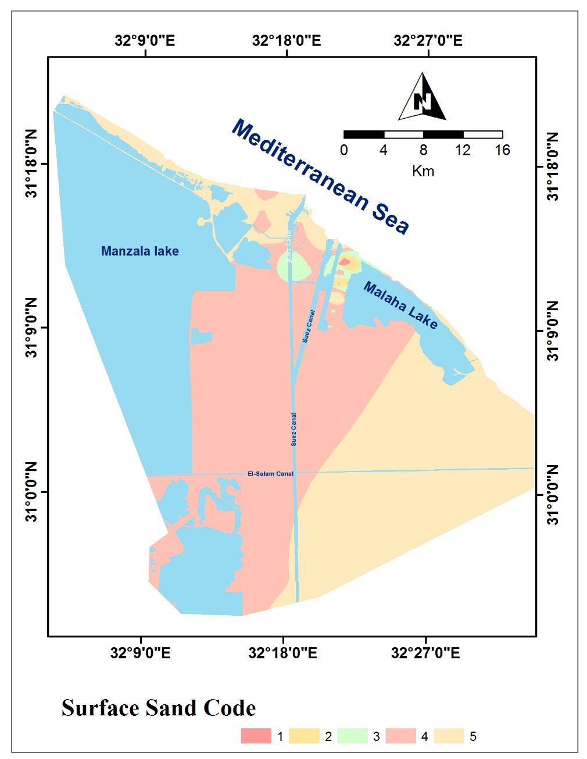
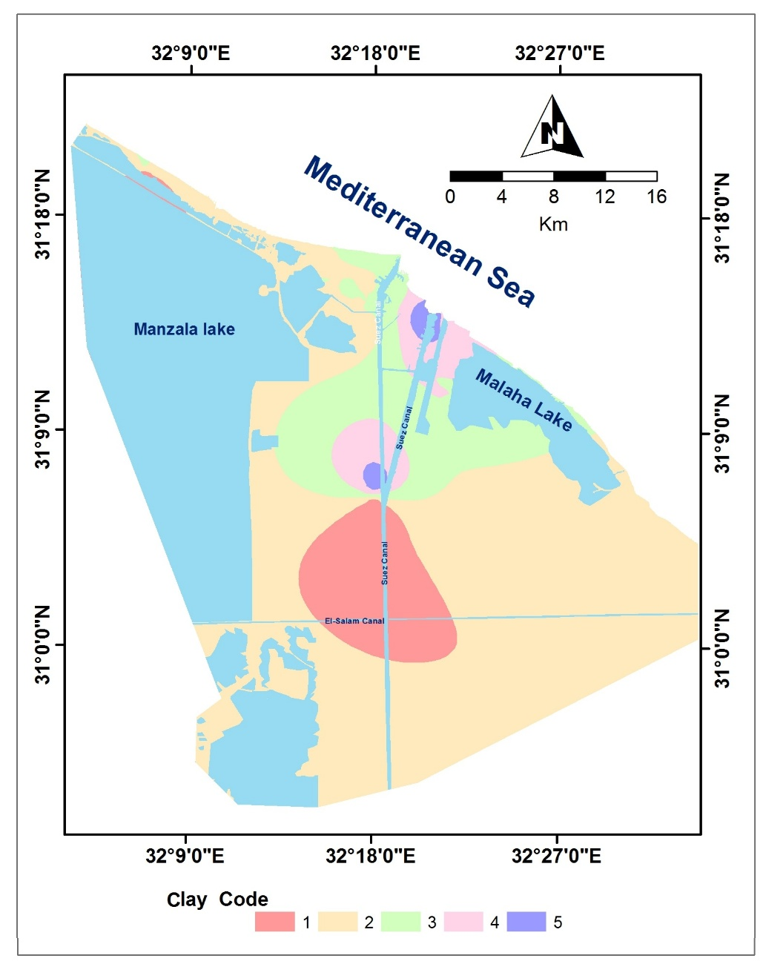
Sub Surface Data
Subsurface Geologic layers maps
Tectonic Framework

Slide 21
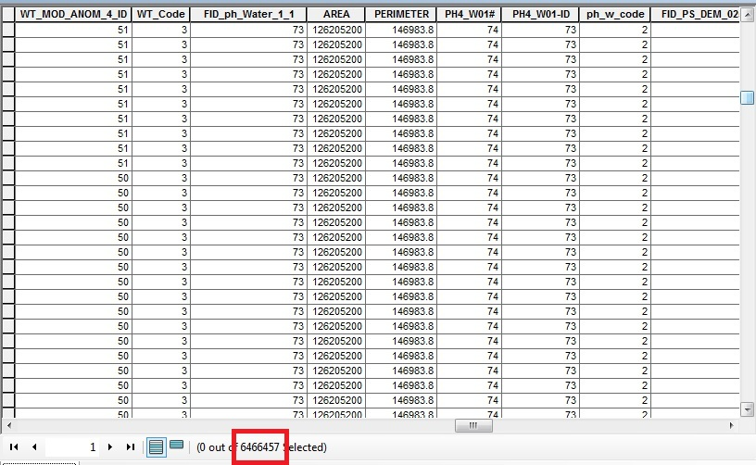
Urban Code

Slide 22
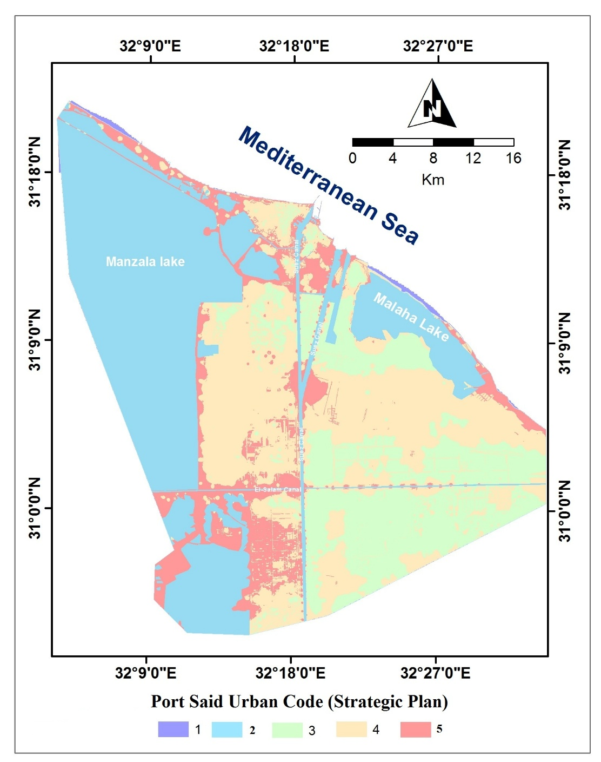
Utilizing All coded Factor Maps
Urban Code Map
Code Suitability Index | Code
Restricted | 1
least suitable | 2
moderately suitable | 3
highly suitable | 4
Ideal | 5

Slide 23

Thank
you

